Slide 1



Slide 2
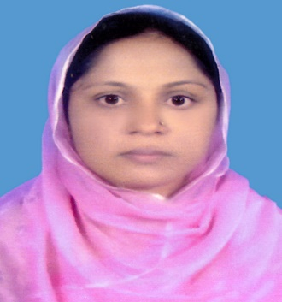

IDENTITY
Selina Akter
Asst.teacher
Bohoddar kata High School
Chakaria,Cox’s Bazar
E-mail: selikamal8485@gmail.com
Mobile:01815851776
ENGLISH FOR TODAY
CLASS : Nine

Slide 3
Let us enjoy a video
What do you mean by the video?
Shat Gambuj Mosque

Slide 4
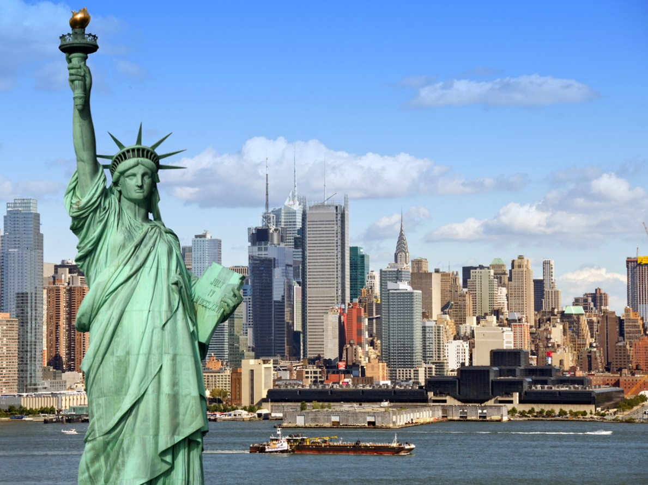
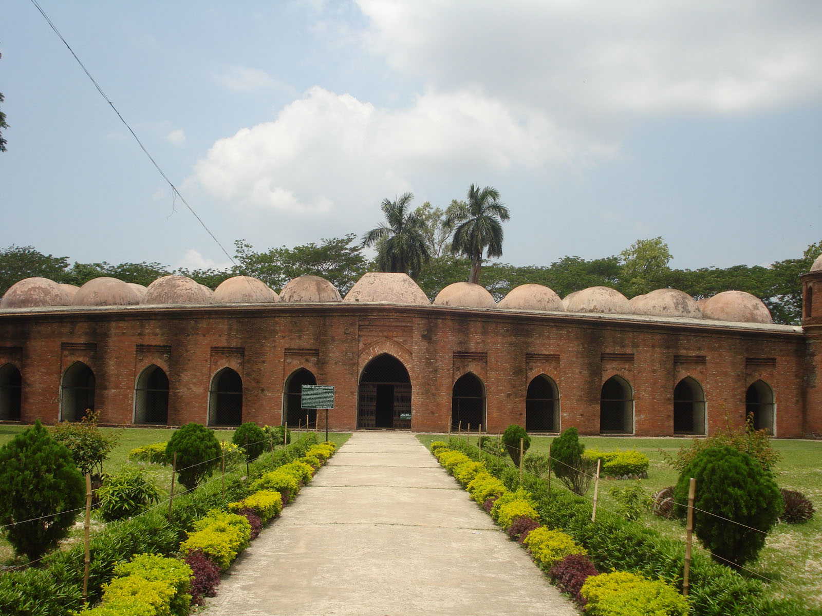
Lets see some pictures-
The Statue of Liberty
Shat Gambuj Mosque
What are this?
A world Heritage

Slide 5
Our today’s topic is-
The Shat Gambuj Mosque (A world heritage)
Unit-8
Lesson-1

Slide 6
Learning outcomes
By the end of the lesson, we will be able to-
ask and answer questions.
read and understand text through silent reading.
describe a place.

Slide 7
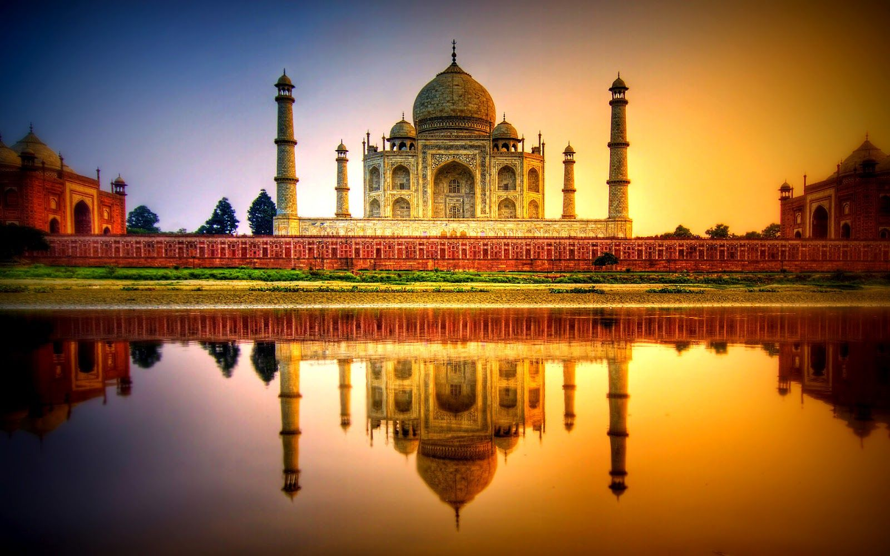
Let us introduce with some new words/key words.
Unique
Meaning : Exclusive/exceptional
Taj Mahal is a unique world heritage.

Slide 8
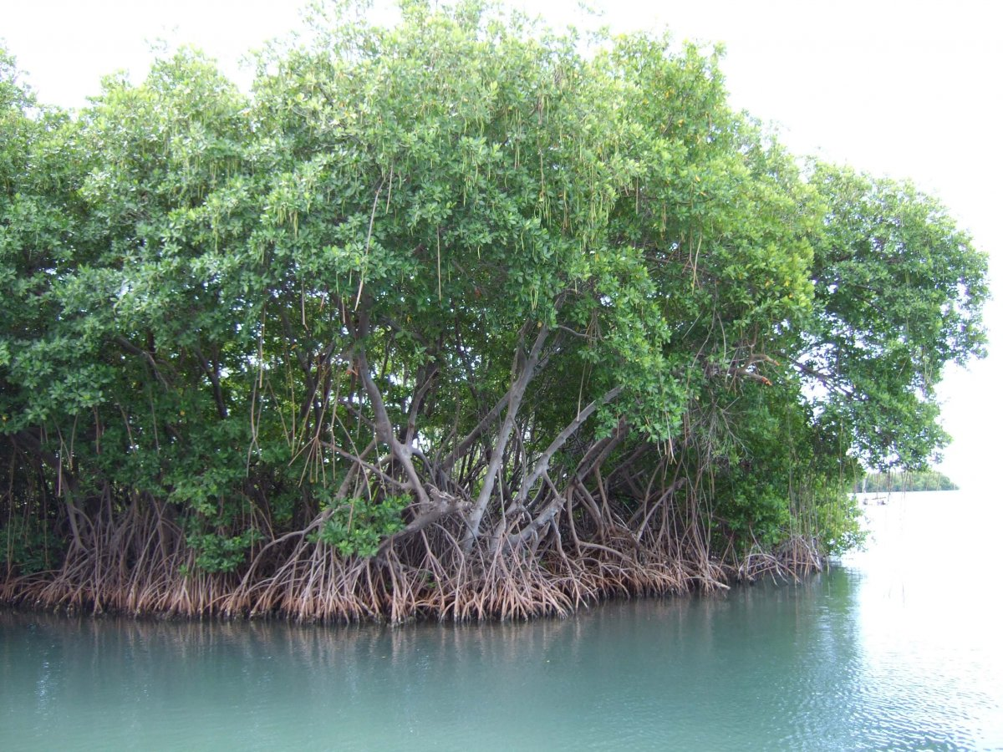
Mangrove
Meaning : Coastal tree/tree grows on river bank
Sunderban is one of the biggest mangrove forests.

Slide 9
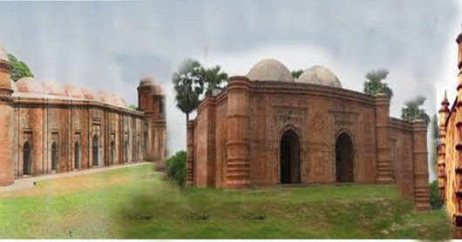
colony
Meaning : Settlement,Locality
khalifatabad was a muslim colony.

Slide 10
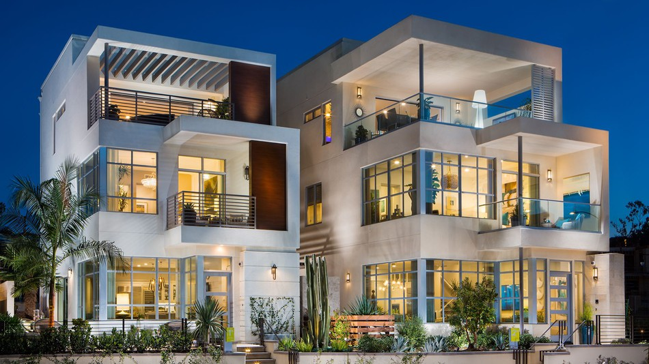
Infrastructure
Meaning : Frame/setup/structure/substructure
The infrastructure of this house is very strong.

Slide 11
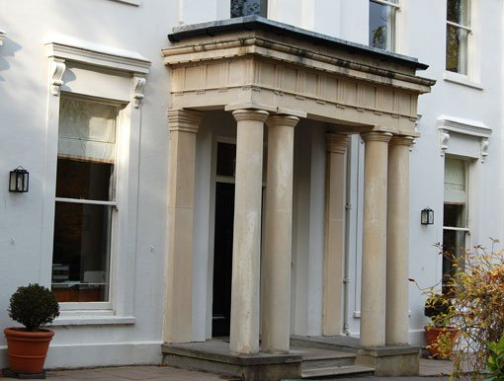
Slender stone column
Meaning : slim/trim
The building is made with slender stone columns.

Slide 12
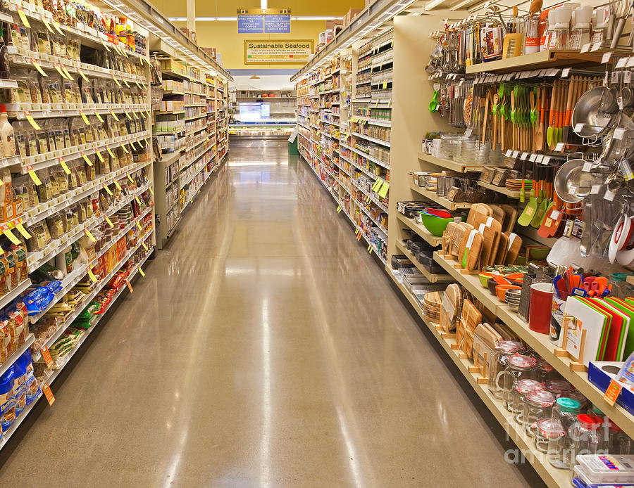
Aisle
Meaning : Narrow way
There are different aisles in this market.

Slide 13
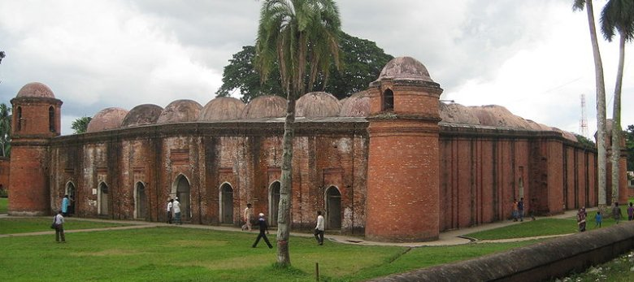
A. look at the picture. Work in pair Talk about the picture and ask and answer the following questions with your partner.
Pair work
What is this building?
Do you have a building like this in your town/village?
3. What do we call it?
4. What is it for?

Slide 14
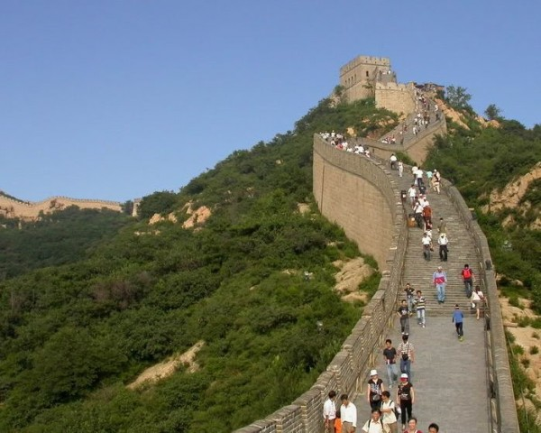
At first we will know what is “Heritage”
“Heritage” is what we inherit from the past
live with them in the present
And then pass on to our children or future generation.

Slide 15
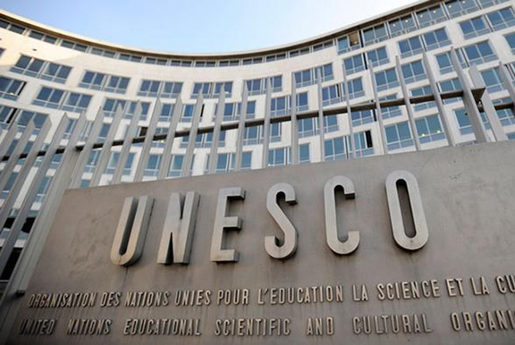
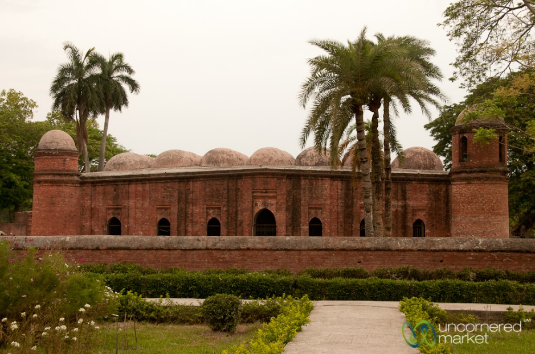
The ‘Shat Gambuj Mosque’ in Bagerhat is such a heritage.
It became a UNESCO World Heritage Site in 1985.

Slide 16
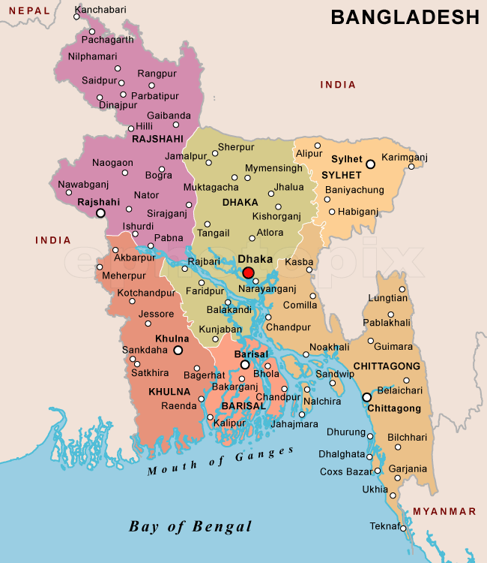
The historic Mosque City was known as ‘Khalifatabad’.It is situated at the outskrits of Bagerhat town.

Slide 17
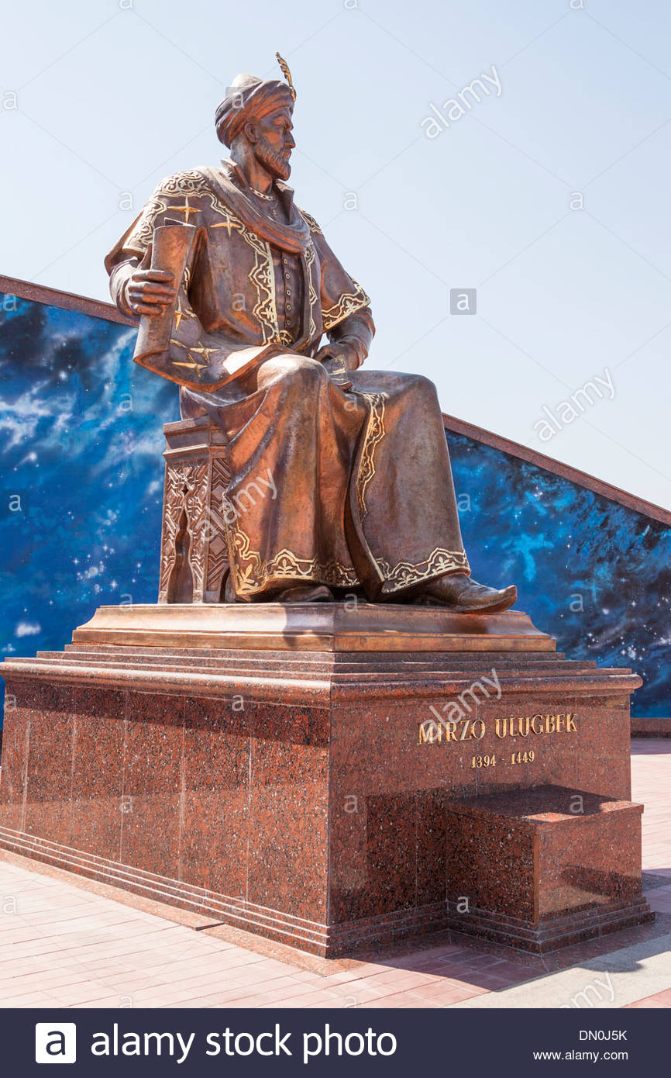
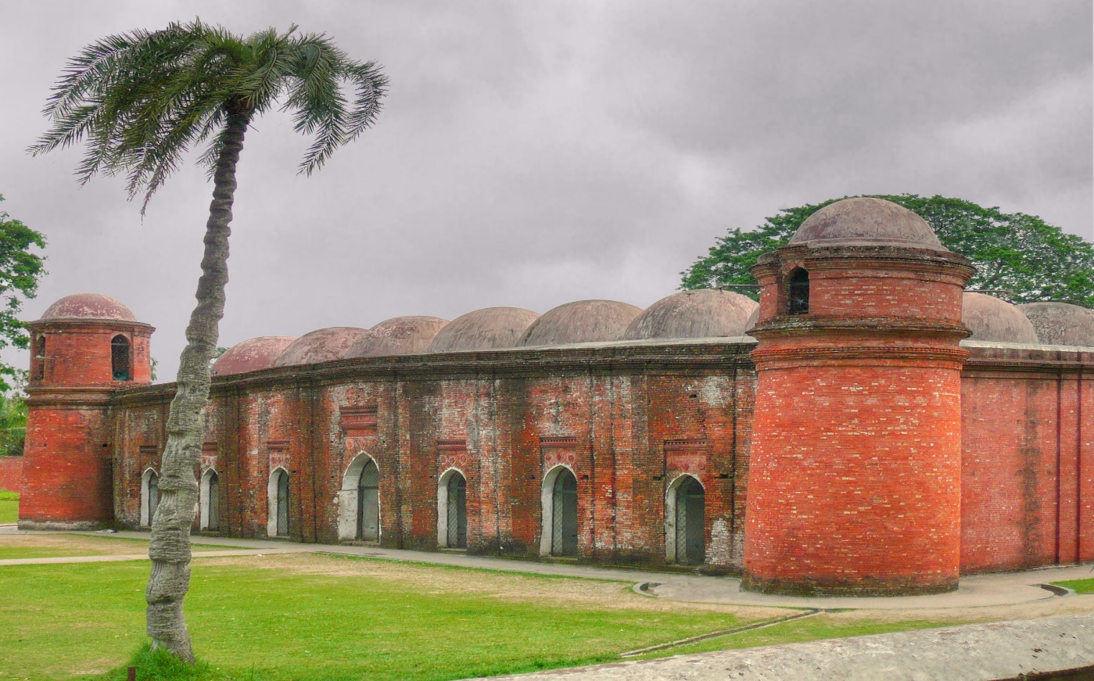
‘Khalifatabad’ was founded by the Turkish general “Ulugh Khan Jahan”

Slide 18
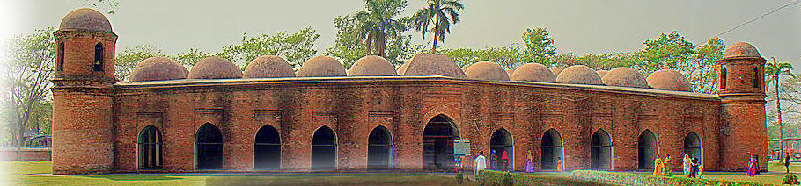
Smaller domes in 4 corners
77 low height domes
11 Arched doorways on east

Slide 19
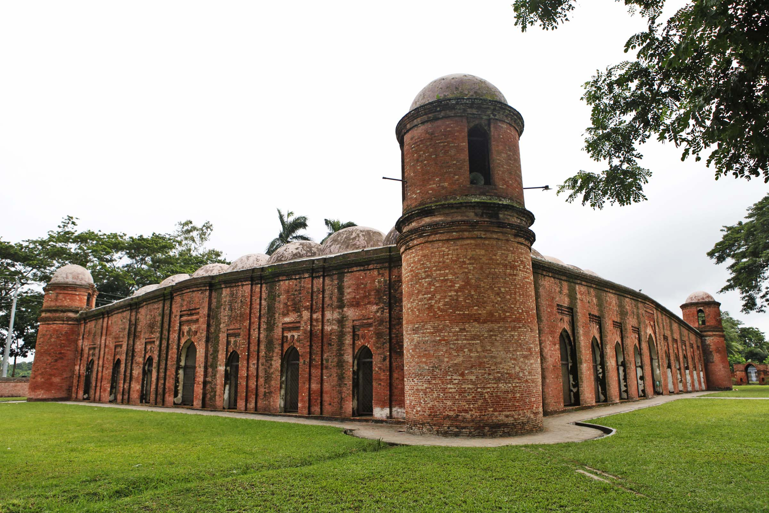
East of the mosque
South of the mosque
7 Arched doors in both south & north

Slide 20
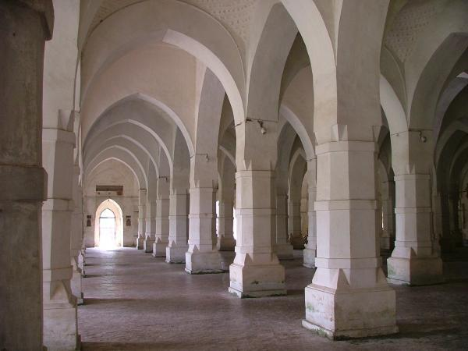
Inside the mosque

Slide 21
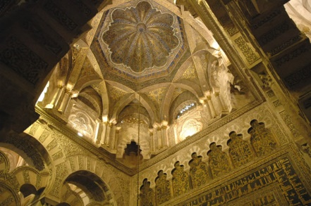
The west wall in the interior has 11 ‘mihrabs’.

Slide 22
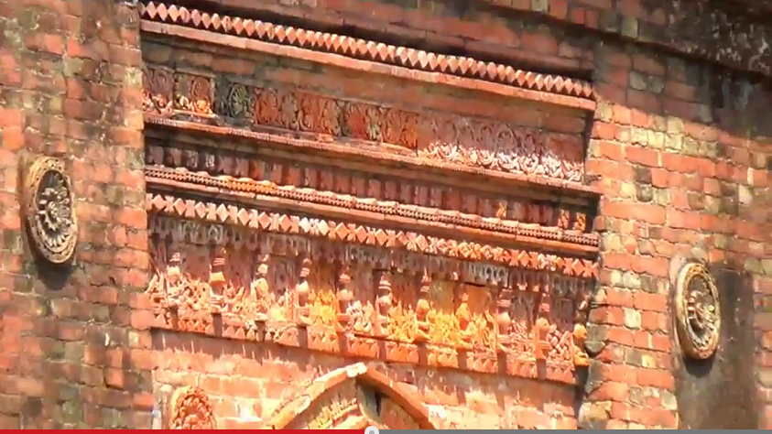
The interior western wall of the mosque is beautifully decorated with terracotta .

Slide 23
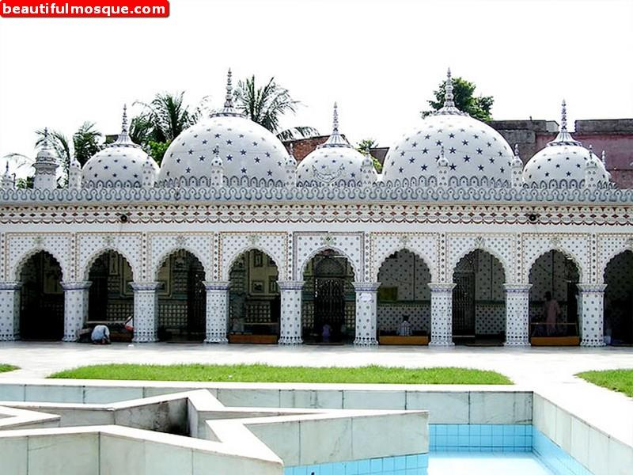
Group work
Look at the picture of the Star Mosque in Dhaka. Write a description on the Star Mosque with the help of the given clues. ( See the clues in the text book).

Slide 24
Read the text again and fill the table given in the textbook.
Evaluation
Shat Gambuj Mosque | Information
Founded by
When
Number of domes
Number of pillars
Arches
Thickness of the arches
Mihrabs
Khan Jahan Ali
15th century
77
60
25
6 feet
11

Slide 25

Home work
Write a paragraph on “The Shat Gambuj Mosque”.

Slide 26


